Slide 1
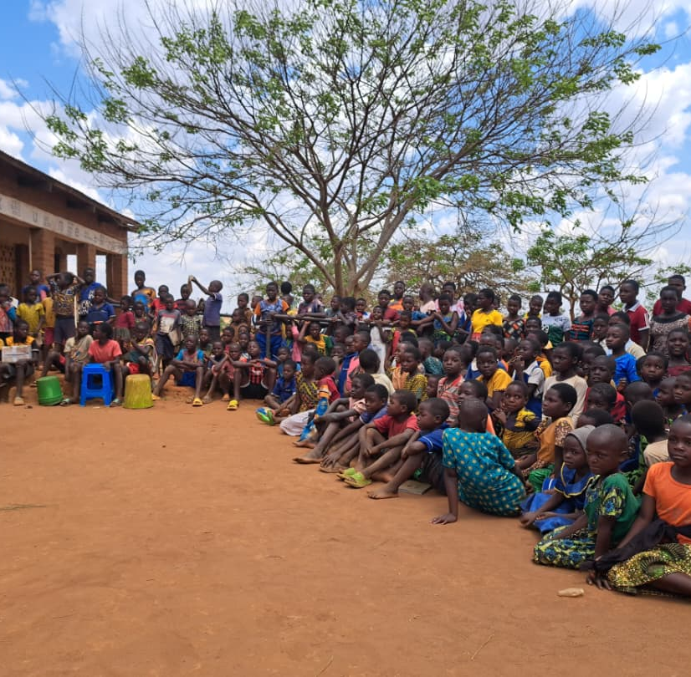
St John’s C. of E. Primary linked with
Mkhalapadzuwa Primary, Malawi
October 2025
African Vision Malawi
Taken over by Gold-youth Development Agency
Homes and Animals

Slide 2
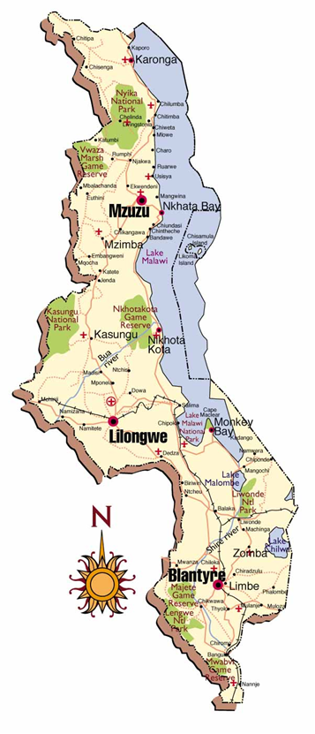
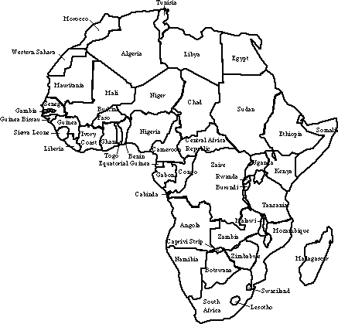
Malawi is a very poor country in Africa. Over 80% of the population live in villages.

Slide 3
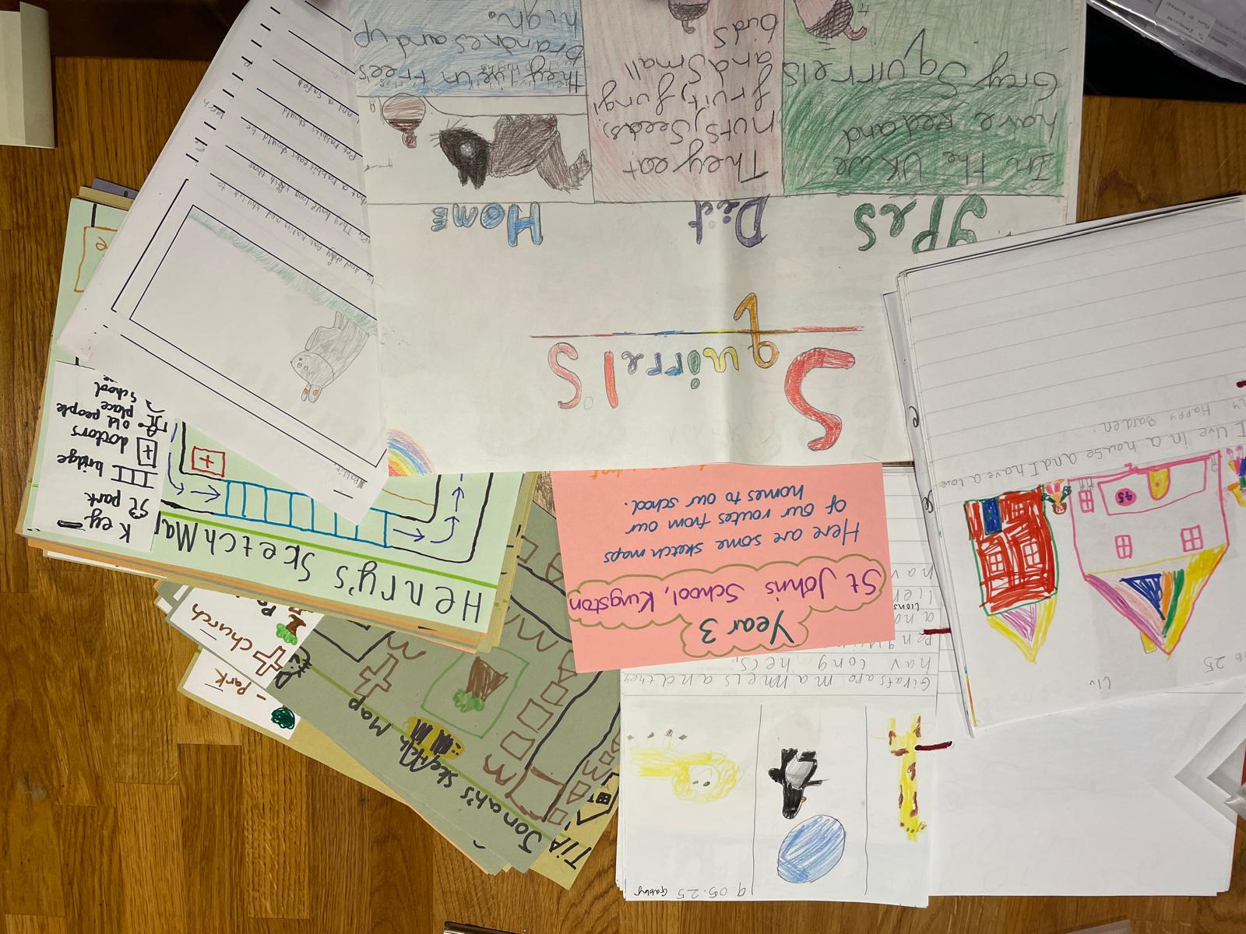
Thank you for your amazing school pack on Homes and Animals

Slide 4
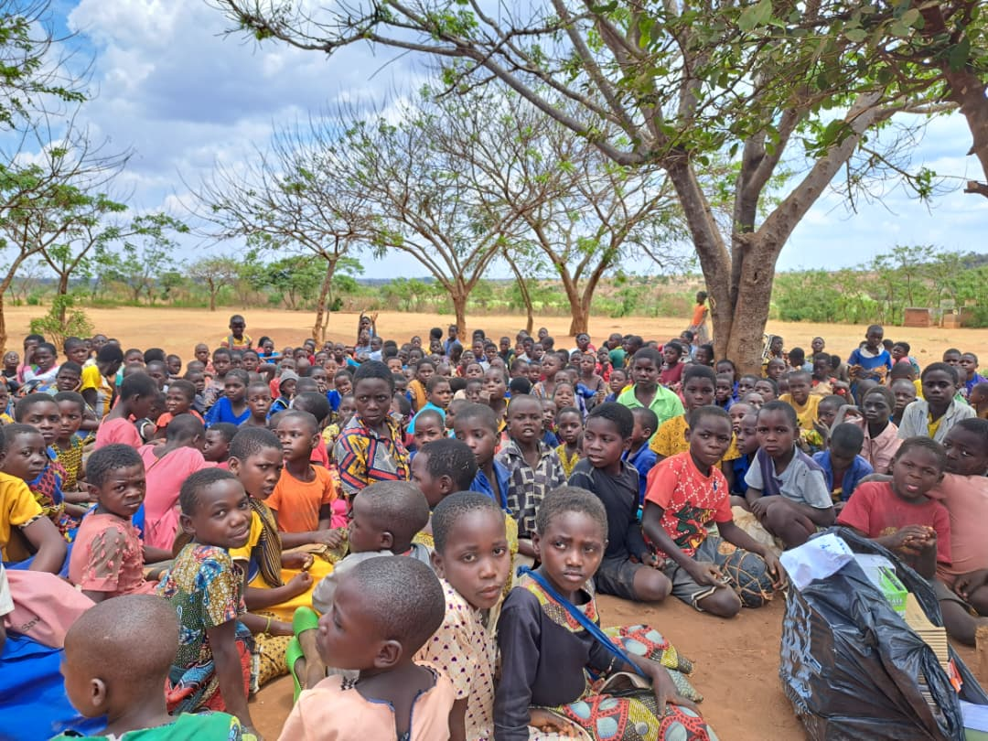
The children were very happy to receive your pack and to learn about homes and animals in England!

Slide 5
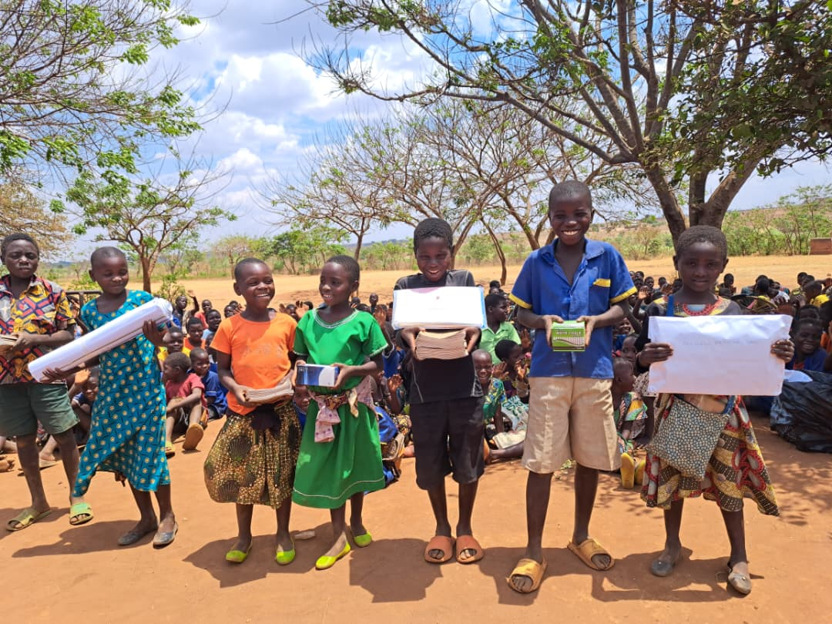
We used money from St John’s to buy learning resources for Mkhalapadzuwa.
Thank you very much!
  200 exercise books
  1 box of 100 pens
  1 box of 100 pencils
  2 flipcharts
  1 box of chalk
  rulers

Slide 6
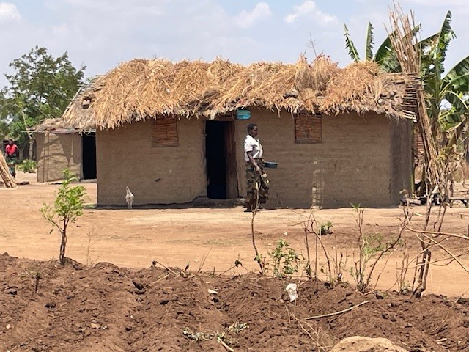
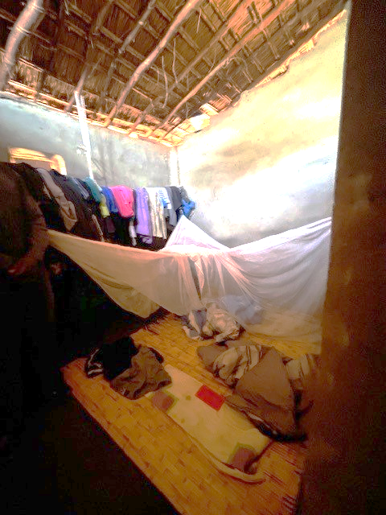
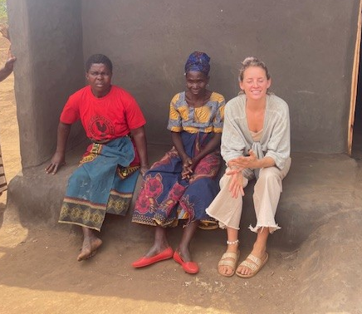
Village homes are made with mud bricks and have a grass roof. They are not very strong and are often destroyed by wind and rain!

Slide 7
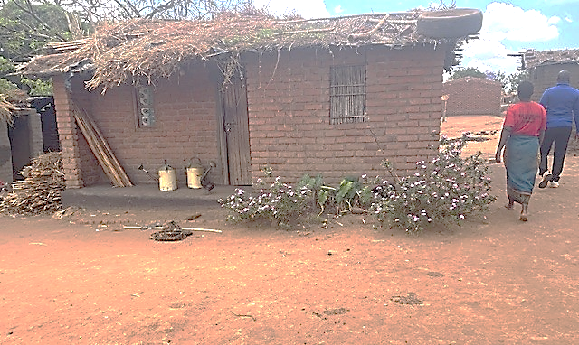
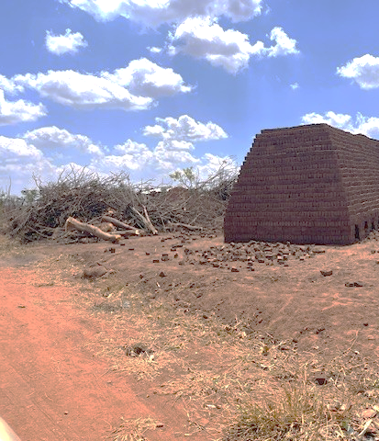
Some villages have a homemade brick oven so they can fire the bricks to make them stronger.

Slide 8
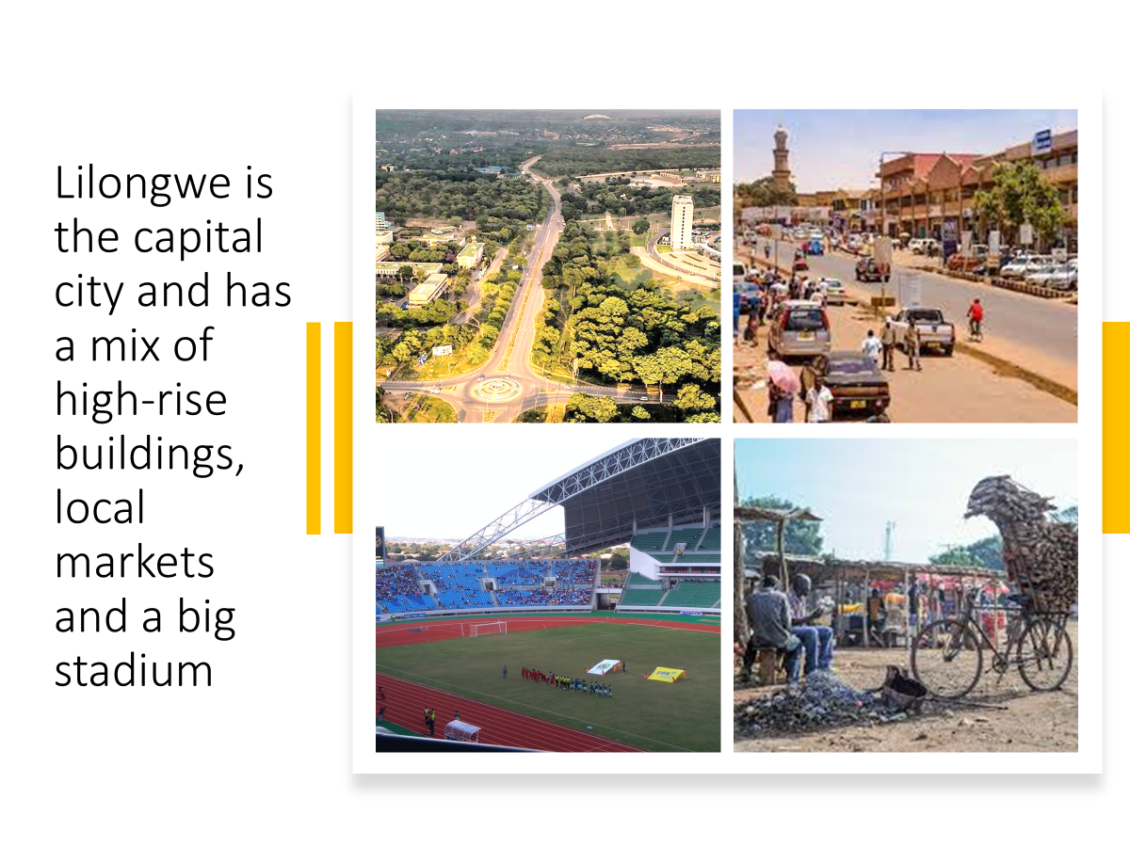

Slide 9
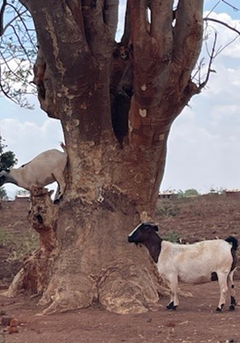
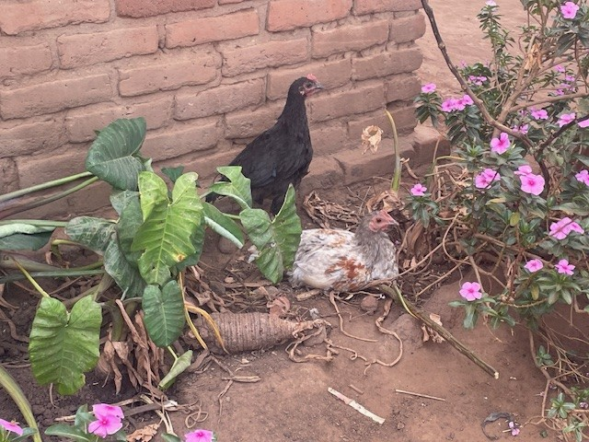
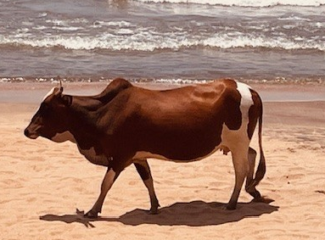
They have farm animals like goats, pigs, cows and chickens but they don’t keep pets like we do.

Slide 10
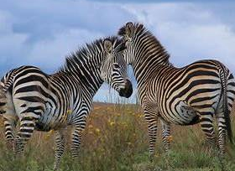
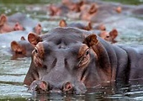
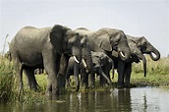
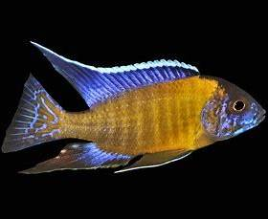
They have many wild animals in National Parks and you can go on safari. Lake Malawi has 1,000 species of tropical fish!

Slide 11
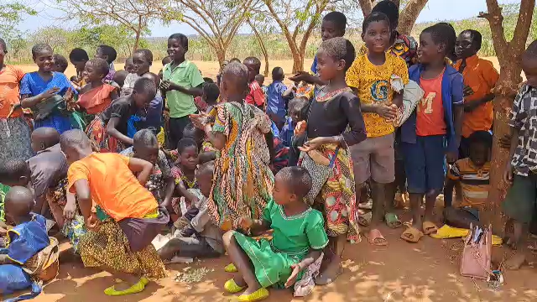

Slide 12

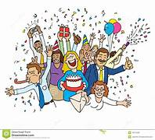
Thank you for all your support!
The next theme is:
Celebrations and Traditions
Birthdays
Easter
Christmas
EID
Weddings
Guy fawkes
To be collected end of June please

